Slide 1
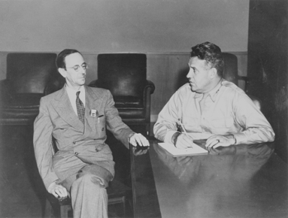
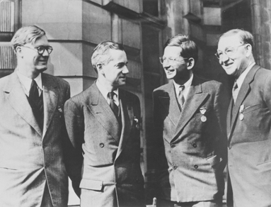
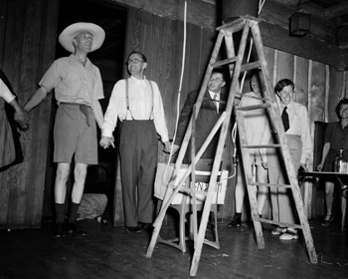
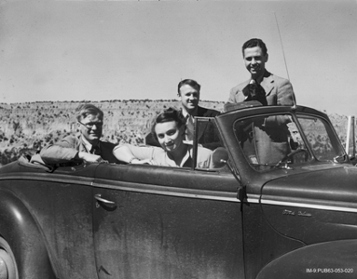
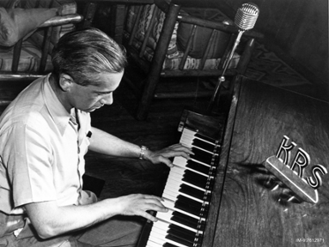

The British Mission at Los Alamos

Slide 2
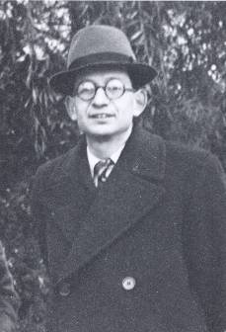
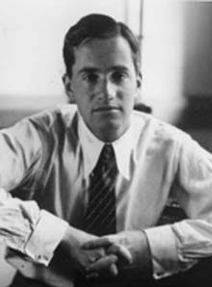
The Frisch-Peierls Memo
Fission is discovered in Germany in 1938
Einstein warns FDR in a letter dated August 2, 1939
Germany invades Poland on September 1, 1939
In early 1940, the Frisch-Peierls Memo is completed
“The attached detailed report concerns the possibility of constructing a ‘super-bomb’ which utilises the energy stored in atomic nuclei as a source of energy. The energy liberated in the explosion of such a super-bomb is about the same as that produced by the explosion of 1,000 tons of dynamite.”

Slide 3
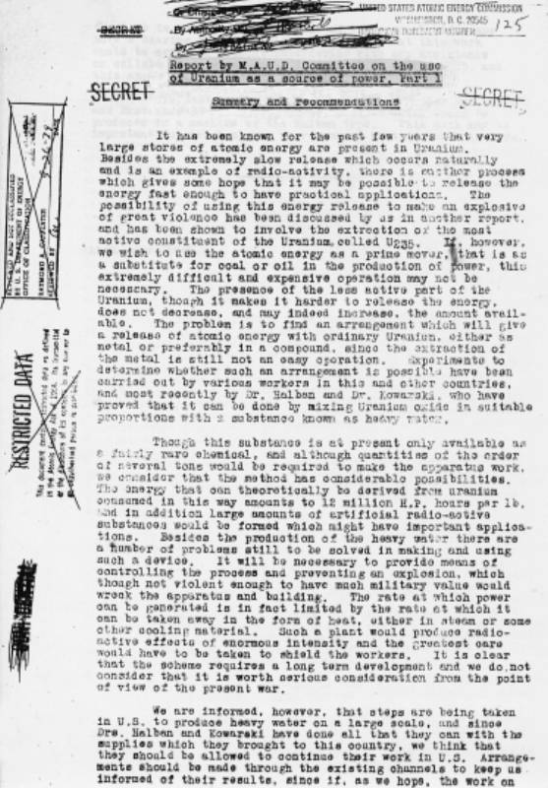
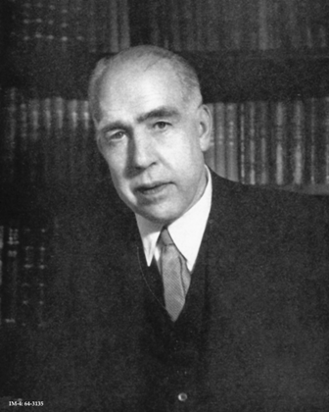
Maud Ray Kent?
The British Government sponsors a feasibility study
In spring 1940 the Maud Committee is created
The “Maud” Committee??
The committee completes its report in July 1941
“..the first bomb would be produced by the end of 1943.”

Slide 4
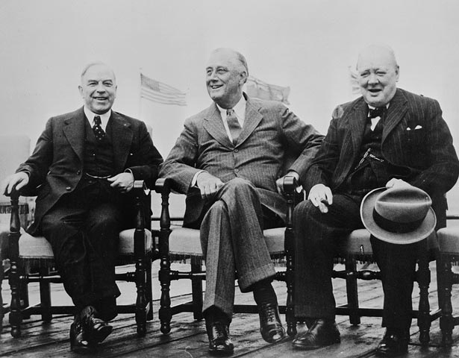
The Quebec Agreement
The Maud report and Pearl Harbor spur the US project
British politicians favor independent projects
The British project falls behind its US counterpart in 1942
With the lead, the US stops sharing information
Britain now tries to salvage the role of junior partner
Churchill personally negotiates a deal in July 1943
The Quebec Agreement is signed August 19, 1943
“In the field of scientific research and development there shall be full and effective interchange of information and ideas..”

Slide 5
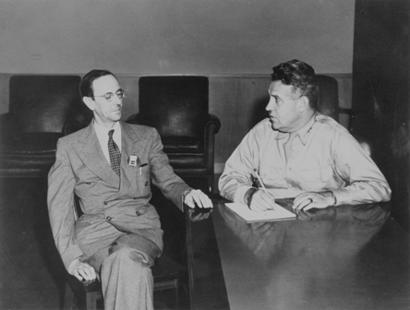
The British Arrive in America
The British begin arriving in America immediately
Some Brits work on gaseous diffusion
Others work on electro-magnetic separation
The largest group comes to Los Alamos
Nobel Laureate Sir James Chadwick leads the group
Peierls soon takes the lead at Los Alamos
Chadwick remains in DC
“..I cannot escape the feeling that without active and continuing British interest there probably would have been no atomic bomb to drop on Hiroshima.”

Slide 6
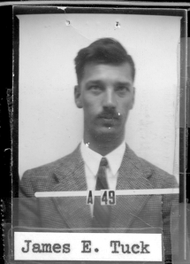
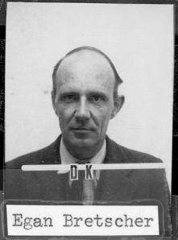
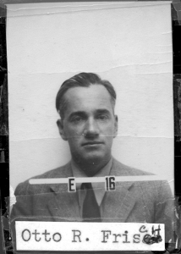
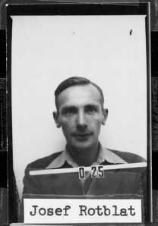
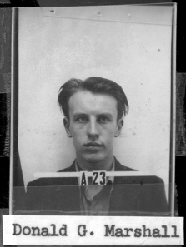
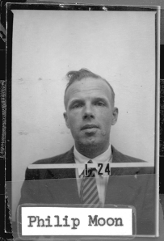
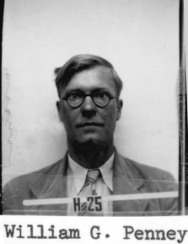
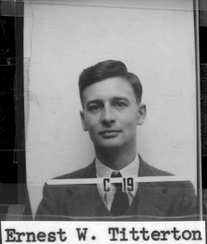
A Motley Crew
British Subjects
James Chadwick
Anthony French
James Hughes
Derrik Littler
Carson Mark (Canada)
William Marley
Donald Marshall
Philip Moon
William Penney
Michael Poole
Harold Sheard
Tony Skyrme
Geoffrey Taylor
Ernest Titterton
James Tuck
Foreign-Born
Aage Bohr, consultant (Denmark)
Niels Bohr, consultant (Denmark)
Egon Bretscher (Switzerland)
Boris Davison (Russia)
Otto Frisch (Austria)
Klaus Fuchs (Germany)
Rudolf Peierls (Germany)
George Placzek (Czechoslovakia)
Joseph Rotblat (Poland)

Slide 7
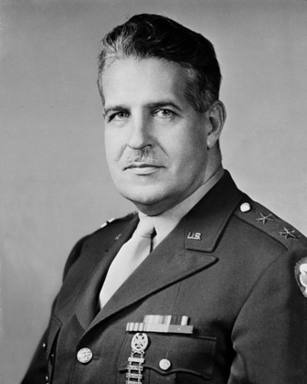
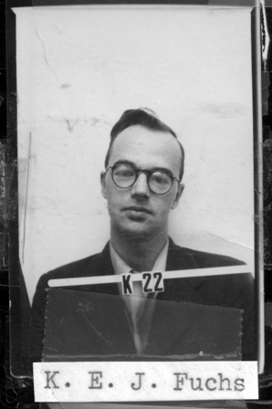
Klaus Fuchs
Fuchs is a German-born member of the communist party
He flees Germany in 1933 shortly after Hitler is appointed
He completes his PhD at the University of Bristol in 1937
In 1942, Fuchs becomes a British citizen
Peierls recruits him to work on the bomb project
During his employment at Los Alamos, Fuchs provides the Soviet Union with classified information
“The United Kingdom not only failed us, but herself as well.”

Slide 8
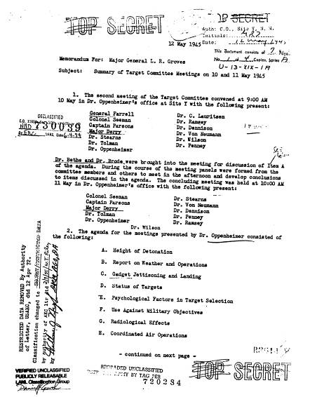
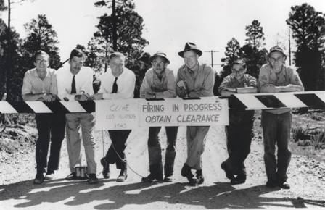
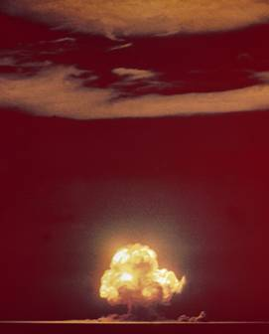
Technical Contributions
Peierls, Frisch, Bretscher, and Placzek all serve as group leaders
Peierls and Fuchs play critical roles in the Hydrodynamics Group
Tuck is instrumental in developing the implosion lens system
Taylor predicts phenomena associated with the Trinity test
Penney measures the blast and serves on the Target Committee

Slide 9
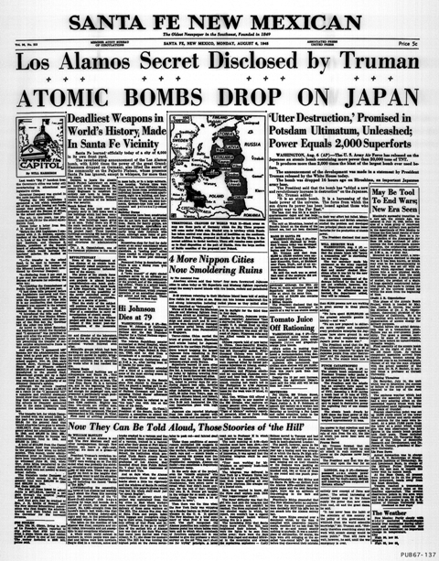
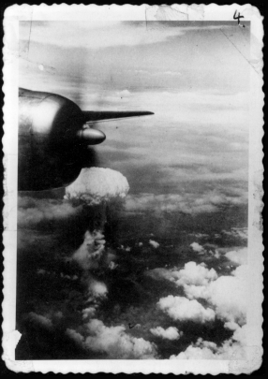
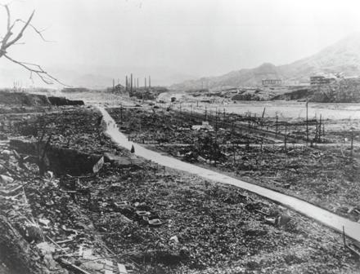
The End of World War II
The atomic strikes are launched from Tinian
Hiroshima is attacked on August 6, 1945
80,000 are killed immediately by the 15 kiloton blast
Nagasaki is bombed on August 9
45,000 are killed immediately by the 21 kiloton blast
Japan unconditionally surrenders on August 14

Slide 10
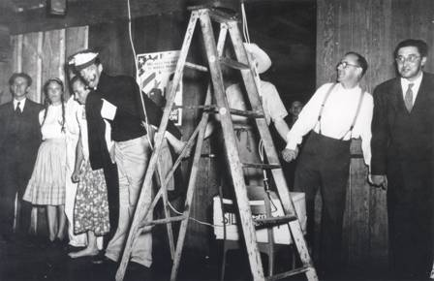
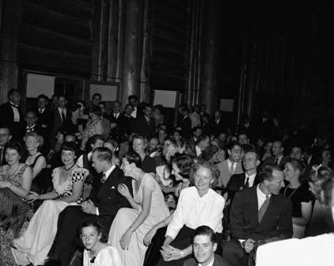
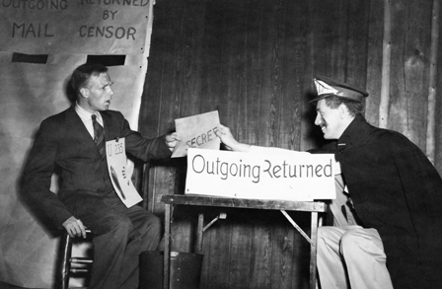
A Celebration
A few weeks after the armistice the British throw a party
The British wives take the lead in organizing the event
Soup, steak and kidney pie, and trifle are served..
..as well as whiskey, brandy, and port wine
Tuck writes a play satirizing security regulations, housing, and the Trinity test

Slide 11
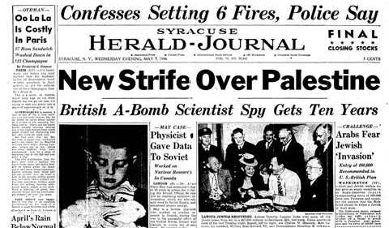
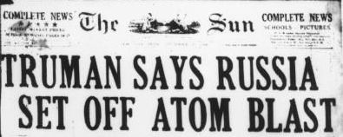
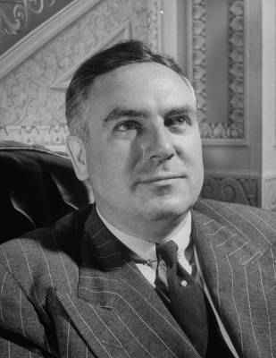
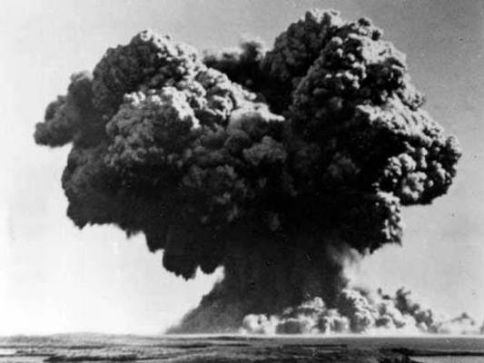
A New World with New Challenges
Several British scientists call for international control
The Atomic Energy Act of 1946 prohibits the exchange of atomic information
On August 29, 1949 the Soviets test Joe-1
In early 1950 Fuchs is arrested in Britain for espionage
A few months later, Julius and Ethel Rosenberg are arrested
In October 1952, the UK tests its first bomb

Slide 12
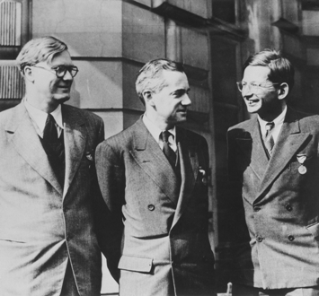

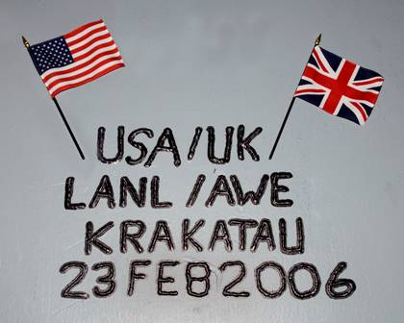
The Legacy of the British Mission
General Groves: “On the whole, the contribution of the British was helpful but not vital.”
The British made important technical and social contributions
Wartime cooperation foreshadowed the Mutual Defense Agreement
Under the auspices of the MDA, the US and UK have conducted dozens of full-scale and subcritical nuclear tests

Slide 13
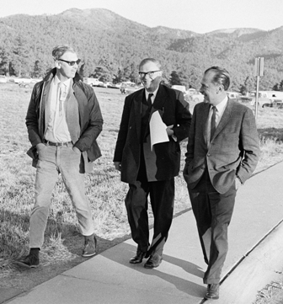
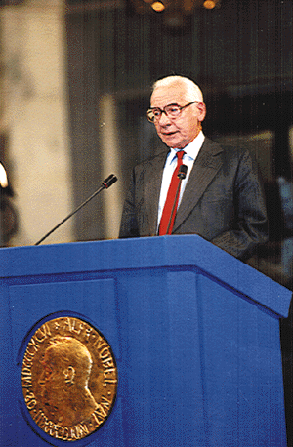
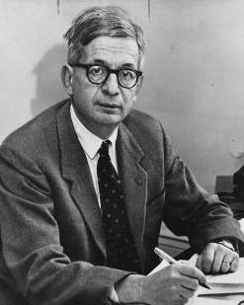
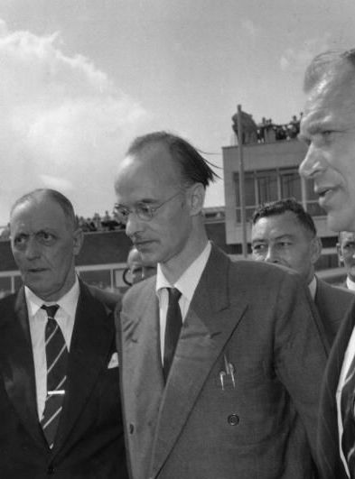
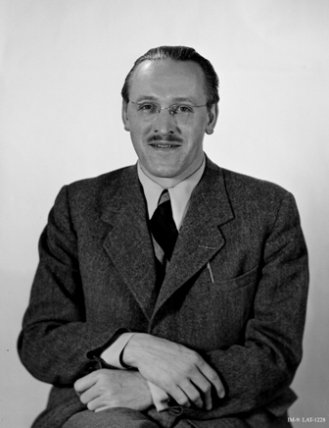
Epilogue
Mark becomes a US citizen and serves as T Division leader for 25 years
Tuck becomes a US citizen and spends the remainder of his career at Los Alamos
Fuchs is released after serving nine years in prison and immigrates to East Germany
Penney becomes the “British Oppenheimer” and is knighted
Rotblat leaves the project early and later wins the Nobel Peace Prize
Peierls is knighted in 1968

Slide 14

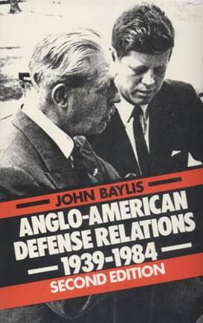

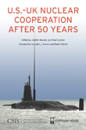
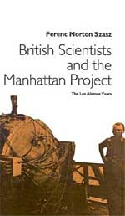
Further Reading
John Baylis. Anglo-American Defense Relations, 1939-1984
Margaret Gowing. Britain and Atomic Energy, 1939-1945
Lillian Hoddeson, et al. Critical Assembly: A Technical History of Los Alamos during the Oppenheimer Years, 1943-1945
Jenifer Mackby and Paul Cornish, eds. U.S.-UK Nuclear Cooperation After 50 Years
Ferenc Szasz. British Scientists and the Manhattan Project

